Slide 1

Descentralización fiscal y fuentes de ingreso sub-centrales
Alan Carter (Economista fiscal senior y líder del Secretariado del DIF)
Primera Reunión de la Red Iberoamericana de Responsables de Política Fiscal
San José, Costa Rica
5-6 de Noviembre, 2013

Slide 2
Principales temas de la presentación:
¿Cuál es el significado de ‘descentralización’?
Panorama global y tendencias
Distribución de poderes y responsabilidades
¿Quién debería gravar, y qué?
Conclusiones
Anexo (cuestiones sobre transferencias/compensación y deuda)

Slide 3
Descentralización
La descentralización se refiere a la tendencia global de delegar las responsabilidades de gobiernos centrales a gobiernos locales o regionales
Beneficios potenciales
Mejoras en la eficiencia (a través de competición intergubernamental y disciplina fiscal)
Incremento de la gobernabilidad y rendición de cuentas a través de una mejor interacción entre mecanismos de voz/control locales y la prestación de servicios
No obstante surgen interrogantes respecto de si la asignación de poderes impositivos y para ejecución del gasto en gobiernos de nivel inferior crea la disciplina y los incentivos necesarios para asegurar, en la práctica, eficiencia en la productividad

Slide 4
Descentralización
La idea detrás de la descentralización es que diferentes comunidades, geográficamente separadas, enfrentan problemas distintos (que pueden ser impercetibles para el gobierno central) y por lo tanto requieren soluciones distintas.
Los gobiernos centrales no tienen la capacidad de abordar el sinnúmero de situaciones que ocurren en el nivel local
Para solucionar problemas, los futuros sistemas de gobierno posiblemente requerirán mayor descentralización y mayor participación de la sociedad civil y del sector privado.
Ahora bien, cómo se financian los gobiernos descentralizados y qué se descentraliza?

Slide 5
Alternativas
Devolución – poder político disperso
Transfiere responsabilidades gubernamentales a los niveles locales y regionales y las elimina del ámbito del gobierno central
Delegación– dispersión limitada del poder político
Transfiere algunas responsabilidades a niveles inferiores de gobierno, pero no aquellas que se relacionan con decisiones clave de la administración
Desconcentración – poder político no-disperso
Descentralización espacial del gobierno central o la administración triutaria a través de la creación de oficinas locales o regionales, pero manteniendo el control a nivel nacional

Slide 6
Descentralización y grado de desarrollo económico
Diferencias entre la descentralización en países en vías de desarrollo y países desarrollados
¿Por qué?
Muchas de las suposiciones hechas en la literatura sobre descentralización, tales como la pesencia de voz y salida (presence of voice and exit), no resultan aplicables en países en vías de desarrollo
Mobilidad limitada por la pobreza y mercados laborales, de bienes y capital ineficientes; así como aversión riesgosa provocada por la ausencia/insuficiencia de social safety nets
Déficit de responsabilidad y rendición de cuentas debido a sistemas electorales corruptos o ausentes

Slide 7
Tendencias globales en materia de descentralización fiscal
Las tendencias en materia de descentralización (en general) y descentralización fiscal son difíciles de identificar, no obstante la base de datos del Manual de estadísticas de finanzas públicas (MEFP) del Fondo Monetario Internacional puede servir como punto de partida
GL2 = Gobierno central
GL3 = Gobierno en su totalidad

Slide 8
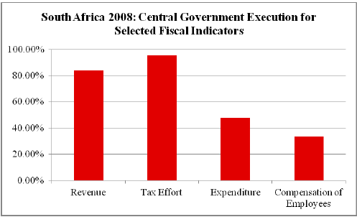
Ejemplo-país; proporciones GL2/GL3 de indicadores seleccionados

Slide 9
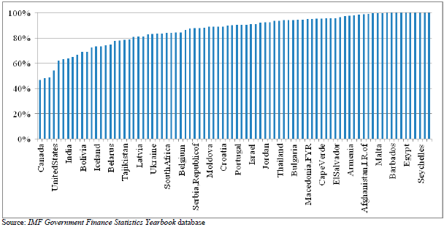
Distribución de proporciones GL2/GL3 (Ingreso) 74 países, porcentajes del 2008

Slide 10
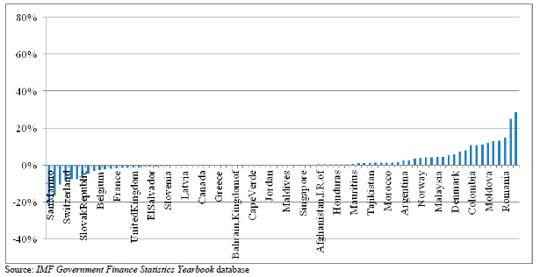
Cambios en GL2/GL3 en relación con el ingreso en 74 países \ (1990-2010)

Slide 11
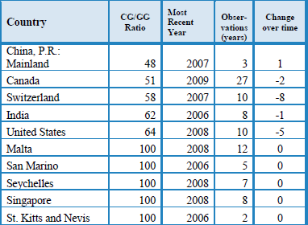
Esfuerzo fiscal (impuestos + pagos obligatorios a la seguridad social) como porcentaje del gobierno general

Slide 12
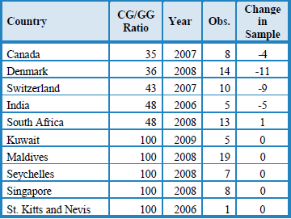
Nivel de gasto del gobierno central como porcentaje del gobierno general: puntos opuestos del espectro

Slide 13
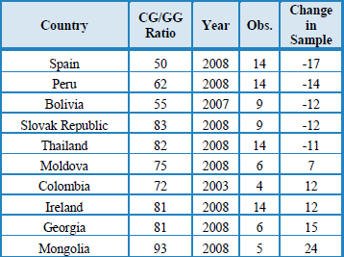
Países con cambios significativos en el gasto del gobierno central como % del gobierno general

Slide 14
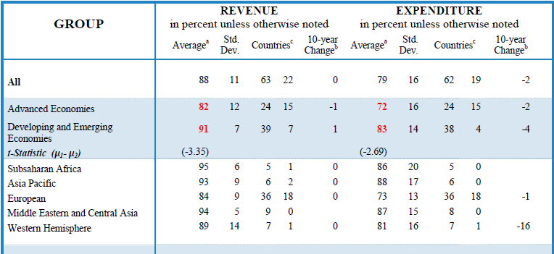
Resumen de estadísticas sobre descentralización fiscal (GL2/GL3) por grupos de países, 2008

Slide 15
Hechos estilizados
Advanced economies tend to be more decentralized than developing and emerging economies.
The tax effort of central government averages 85 percent in advanced economies compared to 92 percent in developing and emerging economies.
Economies with a federal constitution tend to be more decentralized than economies with a unitary constitution but localalisation of income taxes has a big impact in some unitary countries
Economies with large geographic areas tend to be more decentralized than economies with a small geographic area but some noticeable exceptions
Governments tend to decentralize expenditure execution more than revenue collection.
One Implication is that centralisation of revenue collection reflects the high costs for establishing significant tax collection units, and large economies of scale in processing tax collections

Slide 16
Principales advertencias
Taking revenue or expenditure decentralisation to sub-national governments as a unit of analysis for measuring closeness to people is problematic
States or provinces in large countries such as Brazil, Canada, China, India, Brazil, Russia, and the US are larger in population size and area than a large number of small or medium size countries.
intermediate orders of government in large federal countries may be farther removed from people than the central government in smaller unitary states
Administrative structures varies across countries and the number of administrative tiers varies from 1 to 5
Considerable variation in the size of population served by equivalent tiers of government (from thousands in Switzerland to hundreds of thousands in the DRC at the lowest tier)

Slide 17
Asignación al nivel gubernamental apropiado
What are (national) objectives
Implications for direct provision or delegation
Control of those issues that are determined to be of less importance to the central government should be relinquished to lower level governments (or higher if gains from regional cooperation)
But monitoring is necessary to ensure the quality of service provided meets standards and issue of circumstances when/if national government can intervene.

Slide 18
Aspectos claves
The assignment of expenditure responsibilities to each tier of government, generally associated with intergovernmental transfers of funds.
Basic principal is that decision making should occur at the lowest level of government consistent with allocative efficiency
Optimal size for the jurisdiction of each service and service component may vary but myriad of agencies is costly and complex. Hence packaging of responsibilities to different tiers, e.g. road repair and rubbish collection to lowest tier and education and health to regional tier.
More generally, role of functional versus political decentralisation.

Slide 19
Elevando el ingreso
Lower-tier governments are often unable to finance the expenditures for which they are responsible with own-source revenues so need some or all of below:
Vertical or horizontal intergovernmental transfers
To be provided with taxing powers
To be provided with borrowing powers

Slide 20
Tax Options
Transfer of taxing powers is aimed at better matching cost to local residents for the benefits they receive from public expenditure and ensuring they pay (at least part of the cost) of marginal increases in local expenditures they vote for.
But some tax major bases difficult or undesirable to delegate to sub national level
VAT
Income Tax?
Corporate Income Taxes
- And for those that are - principally property taxes - revenues may be low and politically / administratively difficult to increase significantly

Slide 21
¿Quién debería gravar, y qué?
Responsibility for setting the tax base, setting rates, and collecting and administering revenue, differs considerably between unitary and federal countries, and within the various regional economic communities.
Outside of a few large federal countries such as the US and Canada, local income taxes are relatively rare but do exist in countries such as Sweden and Switzerland
VAT has many attractive economic properties in terms of efficiency but its fundamental design properties do not really allow for the
Sub-national variations and decisions about levels and rates of sales taxes allow for greater fiscal decentralisation but result in a more inefficient tax consumption tax system compared with switching to VAT
Formula apportionment (FA) systems also exist in some countries allowing for (some) decentralization of responsibility for corporate taxes but raise many problematic issues (which will be discussed in session 7)

Slide 22
Atributos deseables de fuentes de ingreso sub-nacionales
Tax base should be as evenly distributed as possible across jurisdictions (to limit need for very large equalisation transfers) – natural resources raise particular issues
Tax revenue should not be highly cyclical if flexibility over spending and borrowing is low and/or undesirable
Mobility of tax base should be low
Redistributory element should be low
Link should exist between taxes paid and public services received

Slide 23
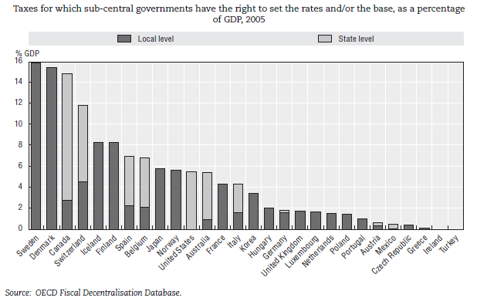
Los poderes impositivos de gobiernos sub-centrales varían ampliamente en países de la OCDE

Slide 24
Modelo ‘Tiebout’ de competencias inter-jursidiccionales: ideas centrales
Competition in service provision and taxation at the local level.
Reduces waste and
Forces local officials to respond to citizens’ priorities
deliver more value for taxpayers’ money
But how realistic is model:
Relatively limited mobility for many due to locational family and job ties
Competition for investment/jobs may not be efficient (e.g. in the US to host (American) football teams) if short run political considerations outweigh long term impacts.
Model assumes political competition via elections works well in delivering desirable economic outcomes.

Slide 25
Poderes impositivos de gobiernos sub-centrales – Una taxonomía de autonomía fiscal
Los gobiernos sub-centrales tienen diferentes grados de control sobre sus propios tributos, entre los cuales:
El derecho de introducir un nuevo tributo
El derecho de derogar un tributo,
El derecho de establecer tarifas,
El derecho de definir bases imponibles,
El derecho de otorgar beneficios o ‘alivios’ fiscales a los contribuyentes.
Nota: los indicadores no consideran en qué nivel gubernamental se recaudan los tributos, en la medida en que esto no es relevante para el concepto de autonomía fiscal. La administración de los tributos y los poderes impositivos son cuestiones separadas!

Slide 26
Grados de autonomía (definiciones de la OCDE)
Five main categories of autonomy
Categories are ranked in decreasing order from highest to lowest taxing power.
“a” represents full power over tax rates and bases,
“b” power over tax rates (essentially representing the “piggy-packing” type of tax),
“c” power over the tax base,
“d” tax sharing arrangements,
“e” no power on rates and bases at all.
“f” represents residual non-allocable taxes.

Slide 27
Taxonomía (OCDE) de poderes impositivos
a.1 a.2 | - The recipient SCG sets the tax rate and any tax reliefs without needing to consult a higher level government. - The recipient SCG sets the rate and any reliefs after consulting a higher level government.
b.1 b.2 | - The recipient SCG sets the tax rate, and a higher level government does not set upper or lower limits on the rate chosen. - The recipient SCG sets the tax rate, and a higher level government does sets upper and/or lower limits on the rate chosen. c.1 The recipient SCG sets tax reliefs – but it sets tax allowances only.
c.2 c.3 | - The recipient SCG sets tax reliefs – but it sets tax credits only. - The recipient SCG sets tax reliefs – and it sets both tax allowances and tax credits.
d.1 d.2 d.3 d.4 | - There is a tax-sharing arrangement in which the SCGs determine the revenue split. - There is a tax-sharing arrangement in which the revenue split can be changed only with the consent of SCGs. - There is a tax-sharing arrangement in which the revenue split is determined in legislation, and where it may be changed unilaterally by a higher level government, but less frequently than once a year. - There is a tax-sharing arrangement in which the revenue split is determined annually by a higher level government.
e | - Other cases in which the central government sets the rate and base of the SCG tax.
f | - None of the above categories a, b, c, d or e applies

Slide 28
Repartición de ingresos
In a number of countries such as Australia and Germany taxes are not assigned to one specific government level but shared between the central and sub-central governments.
Tax sharing arrangements deny a single sub national government any control on tax rates and bases, but collectively SCGs may negotiate the sharing formula with central government.
Negotiating revenue sharing formula key issue when moving from sales taxes controlled at lower levels to nationally implemented VAT

Slide 29
Problemas de la descentralización
Significant redistribution cannot be undertaken at the local level since those being taxes to fund the redistribution will move (“capital flight”)
In many low income countries the main problems are generally not type mismatches in preferences and tastes (solved by “Tiebout model” type competition) but a national demand for basic needs which are relatively similar across the country, hence perhaps less scope for gains from improved allocative efficiency
Deteriorate in sub national government fiscal stability if tax revenue is based on more volatile taxes such as corporate taxes
There is a critical mass beyond which smaller units of government will lack the capacity and/or incentive to engage in the task at hand, e.g. India has more than five times the number of local government entities that China has.
Corruption or “informal taxation” via illegal fees and charges will be decentralized along with everything else.
It may be easier to deter corruption at a national level than a local level in many developing countries/

Slide 30
Conclusiones
Los datos respaldan el conocimiento convencional de que los países de mayor tamaño y desarrollados tienden a utilizar la descentralización de sistemas financieros de manera más recurrente que países de menor tamaño o países con economías emergentes o en vías de desarrollo.
Los mecánismos y fórmulas de transfer/equalisation tienen un impacto significativo en el esfuerzo fiscal de niveles sub-nacionales
La aparición acelerada de economías emergentes sugiere mayor descentralización, sin embargo una reforma sistematizada es inusual. Evolución en lugar de revolución?
Siendo que los poderes constitucionales son relativamente fijos, y que el tamaño geográfico de los países no cambia, y que dichos factores han sido intentificados en la literatura como factores principales para determinar el grado de descentralización fiscal; una nueva forma de pensar sobre los méritos de la descentralización jugaría un papel importante en la formulación de políticas públicas.
Necesitamos una nueva ideología que vaya más allá del conocimiento convencional acerca de cuáles países deberían descentralizar y cuándo deberían hacerlo?

Slide 31
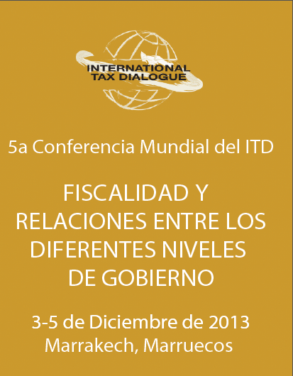
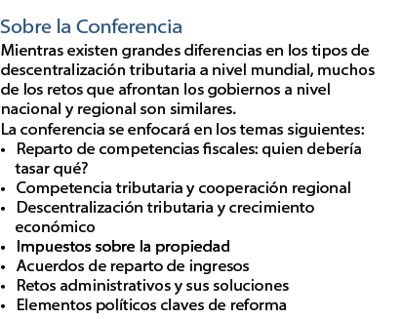
ITD Conference

